Slide 1




Eiffage
Oracle EPM Tax Reporting

Slide 2
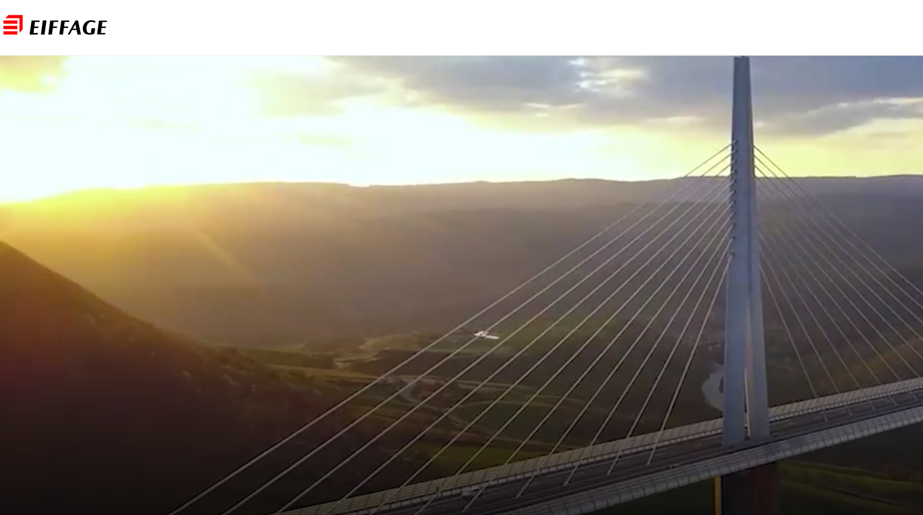
About Us
A key player in a low-carbon Europe, Eiffage is one of the leading European construction and concessions companies. Operating across 8 business lines, organized into 4 divisions, and in 2024, achieved a revenue of 23.4 billion euros.
Driven by their values, the group's 84,400 employees are fully committed to innovating, designing, building, maintaining, and renovating the cities and infrastructures of tomorrow.
“Our main role is to tap into an infinite and entirely renewable resource – our collective intelligence.”
- Benoit de Ruffray – Chairman and CE

Slide 3

















Praesto Consulting: About Us
Specialists in Enterprise Performance Management
With deep expertise across the entire Oracle EPM Suite we provide end-to-end support to the CFO function , implementing purpose-built processes that utilise best practices.
Our diverse industry expertise, technical ability, and agility enable us to leverage world-class solutions, empowering the Office of the CFO to make fast, informed decisions that drive growth, reduce risk, and increase profitability.
For Eiffage our project team comprised deep tax reporting knowledge, technical expertise on the Oracle Tax Reporting process and many years of delivery experience.
Planning & Forecasting
Enterprise Data Management
Profitability & Cost Management
Start anywhere, deploy at your own pace
Narrative Reporting
Freeform
Tax Reporting
Consolidation & Close
Account Reconciliation

Slide 4






Experts in EPM
We understand the value that EPM can bring to your business
Right tool for the job
Automation and AI
Data
The different business processes in the EPM world require different functionalities and different data.
Architecting your EPM solution so that each process accesses the right data, at the right time and provides the right functionality is key.
Utilising embedded best practices enables ease of use and ease of maintenance.
Intelligent process automation and embedded AI enables huge saving in time and effort.
Leveraging advances in AI and continually embracing new functionality will drive continuous improvement in your reporting processes.
Advances in predictive analytics enables deep insight into your business performance.
Seamless data integration, delivering good quality data at the right time is a critical enabler of an efficient process.
Embedding data governance ensures your data quality minimising manual intervention and error.
Delivering granular data enables increased insight.
Insight
Delivering insight into the financial performance of your business, creating forecasts to help predict the performance of your business or strategic plans to shape the direction of your business are key components of your EPM solution.
Efficiency
With ever increasing demands on your team a focus on process, automation and simplicity means your team will gain more time to focus on what matters.
Governance
Embedding control and governance throughout the entire EPM process reduces errors, improves data quality, minimises manual intervention and improves auditability.

Slide 5

Project Challenges
Previously, Eiffage prepared its Country-by-Country Reporting (CbCR) using Excel, manually calculating and compiling the group's accounting and consolidated data. The drawbacks of its use included:
Manual data adjustments
Non-automated process in Excel: limited traceability and security, risk of inconsistent data, difficulty in controlling the overall update of formulas.
Eiffage had identified the need to move to a new process that offered automated data flows, security and a centralised approach.
Eiffage chose to work with us to help them build a more efficient, controlled and reliable CbCR process.

Slide 6




Project Overview | Approach – a 12 week delivery
Scope and Design
Configuration, Integration and Reconciliation
Training and Testing
Go-Live
Organize design workshops to understand requirements and processes
Translate the objectives into best practice
Design an optimised process and system to achieve objectives
Validation of solution design
TRCS environment configured based on the agreed design
Development of integrations for existing data sources
Import and reconciliation of data
Knowledge transfer sessions to aid solution adoption
User training and development of training documentation
Development and delivery of a comprehensive test programme
Support through user acceptance testing
Deployment of the solution to the Production environment
Provision of post Go Live support

Slide 7
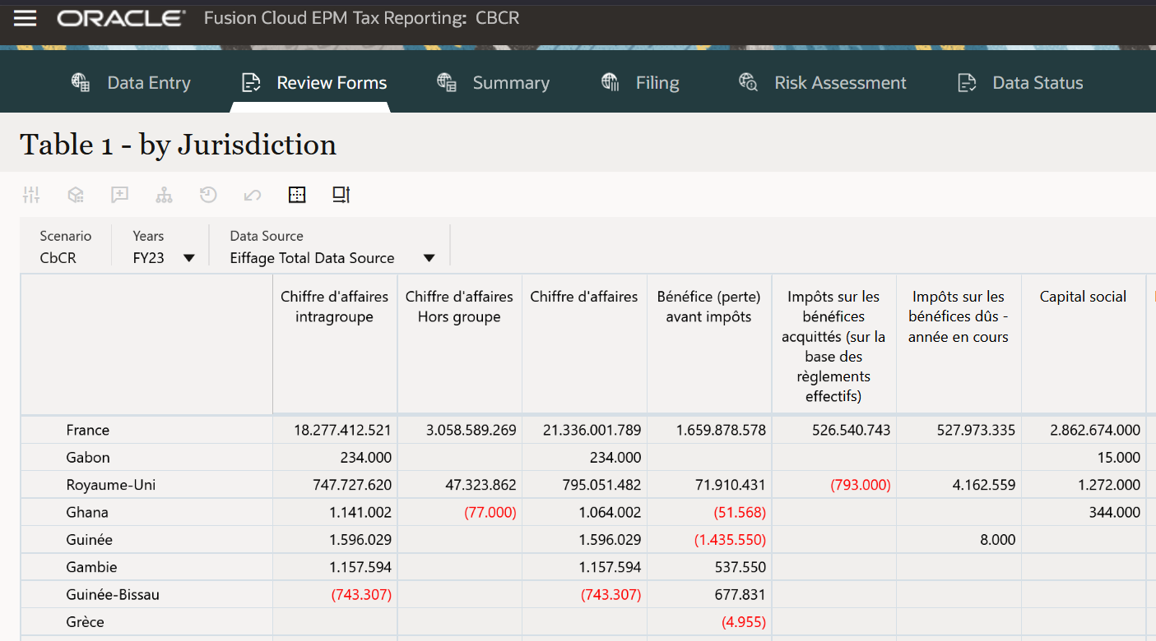
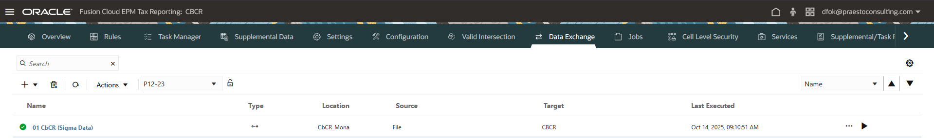

Project Overview | Solution
1. Source files
3. TRCS Table 1
Transformation and aggregation of data
Source data
.CSV
import file
.CSV
export file
4. Export to Cegid Tax Ultimate
2. TRCS Data Integrations

Slide 8
Project Overview | Advantages
The below benefits have been realised:
Automated, auditable, and reliable process – No manual data reprocessing
Centralised application – Data has a single source of truth and all actions are traceable
Data Security - Users only view the data they have access to and execute related processes
Reference frameworks – Structured application containing hierarchies of entities, jurisdictions, and data sources

Slide 9
Project Overview | Next Steps
Eiffage now want to move on to further improve their tax processes:
Implement Pillar II, which will use the CbCR data already integrated into the application
Improve the CbCR process by creating direct connections between:
TRCS and the Sigma consolidation tool, removing the dependency on macro driven Excel workbooks
TRCS and CEGID

Slide 10


Get in touch!
Get in touch to start the discussion!
Interested in how we can help you?
Paul Wilcock
EPM Practice Director
pwilcock@praestoconsulting.com
Hélène Napoly
Managing Director
Praesto Consulting France
hnapoly@praestoconsulting.com

